Slide 1
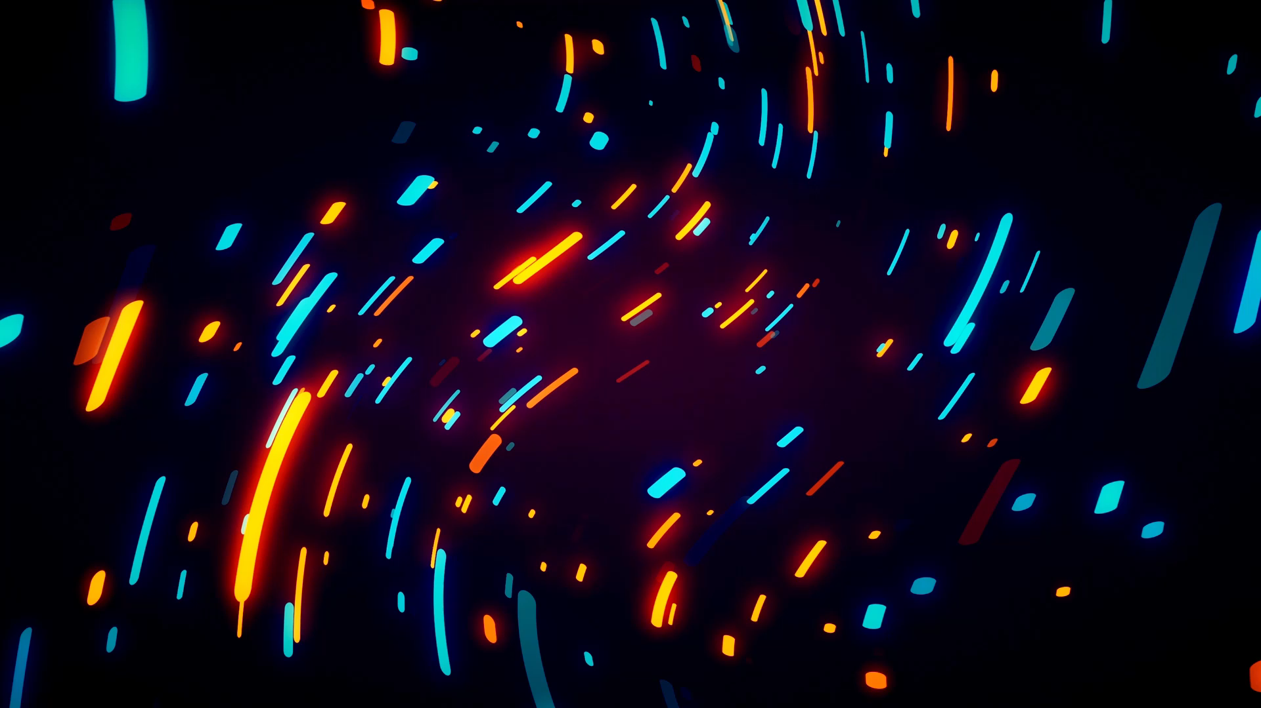

FINAL PROJECT By: Alley chaggar
Game Assets
Notes:
Hello my name is Alley and this is my presentation

Slide 2
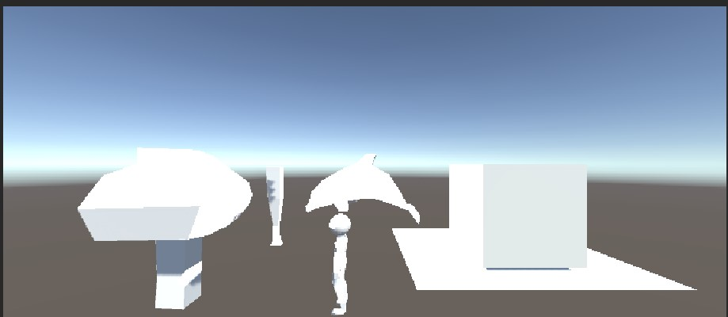
Project overview
Overview
5 assets
Goblin
Weapon
Tree
Dolphin
Transparent glass
Notes:
The project overview was to make a couple of assets. First I used gimp to draw the 2d versions and then
I imported them to blender to be image references.
I animated the characters such as the dolphin and goblin

Slide 3
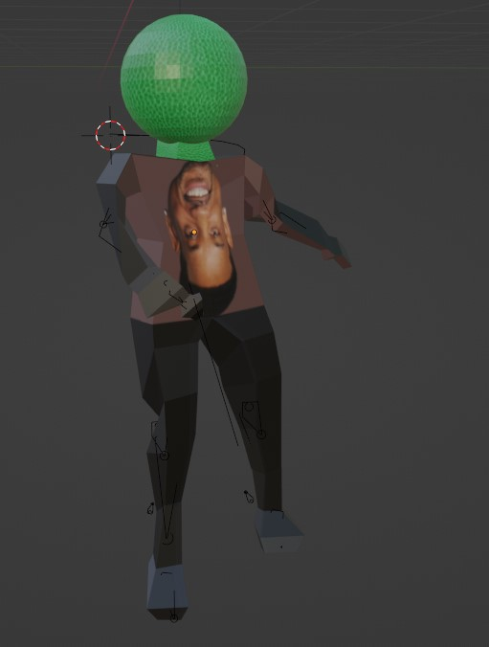
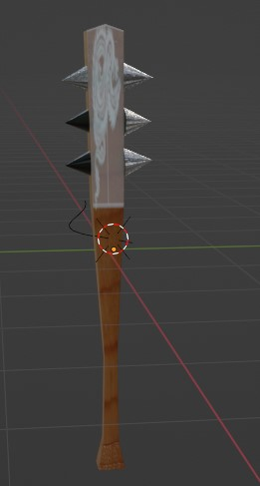
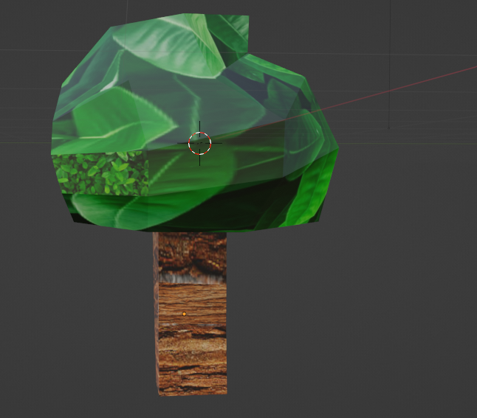
ASSETS
Goblin
Weapon
Tree
Notes:
The first asset is a goblin (I used the same goblin from assignment 3 but I fixed the UV mapping), The goblin’s head and neck is green. I used the image texture for the head and neck. The goblin Has a shirt with Will Smith’s face on it upside down. Where I used the goblin in the scene is right beside the weapon and near then dolphin.
The second asset is a wooden spike weapon ((I used the same weapon from assignment 3 but I fixed the UV mapping), The weapon I made is wooden with iron spikes on it. The iron spikes have less roughness to them than the wooden handle. The UV map is with a dragon on it too. I put this asset beside the goblin.
The third asset is a tree, The tree has materials such as leaves and bark, the UV map is a hole with an owl in it on the tree trunk. Where I put this asset is on the left side of the game scene.

Slide 4
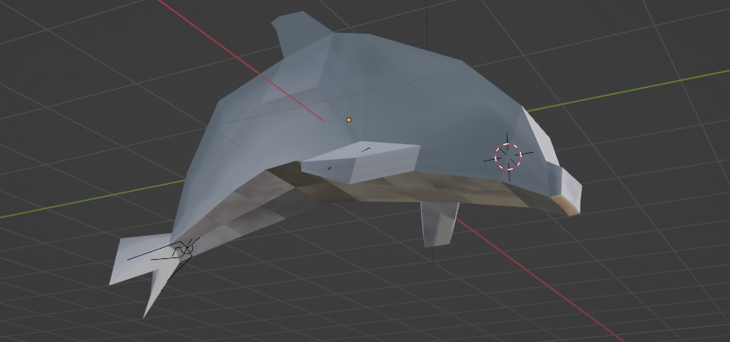
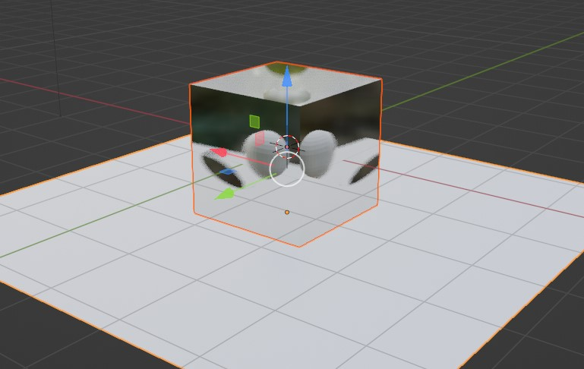
ASSETS
Dolphin
Transparent Glass
Notes:
The fourth asset I made was a dolphin, the dolphin has a material named dolphin skin that is whiteish blueish, the UV map is at the belly of the dolphin to make it seem that the dolphin is darker where its belly is. Where I put this asset is the farthest away from the camera.
The fifth and last asset I made was the transparent glass, the glass has a sphere in it to show that it is transparent and reflective. There is no UV map for it because when I tried to put it I didn’t like how it looked, so I kept it bare instead. Where I out this asset is on the right side of the game scene.

Slide 5
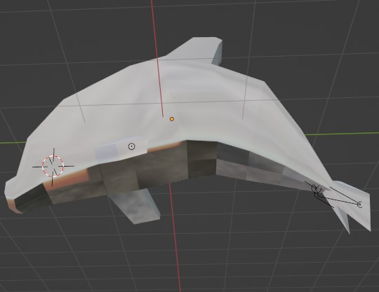
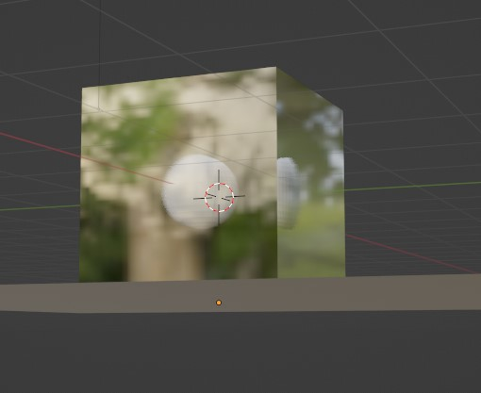
enjoyed most about the PROJECT
Making the glass
Making the dolphin
Notes:
What I enjoyed most about the project was making the transparent glass, and the dolphin, because it was fun animating the dolphin and with the glass it was really cool to move around and play with.

